Slide 1
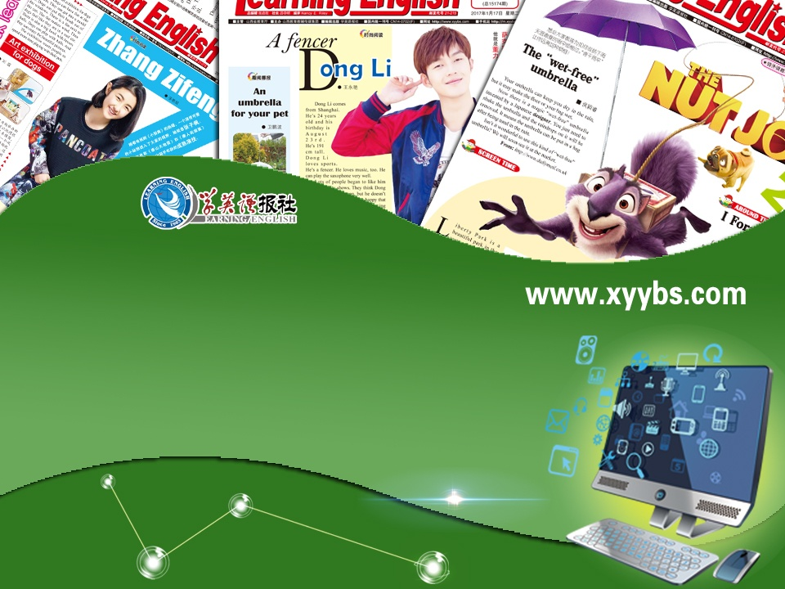
教学辅助课件
牛津 七年级下

Slide 2


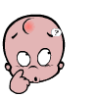
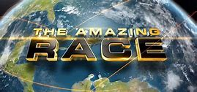
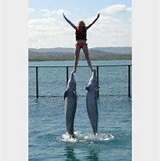
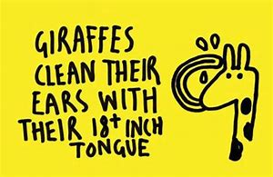
Unit 5 Amazing things
to the unit
amazing performance
amazing facts
令人吃惊的；惊人的

Slide 3



Words & phrase review
amazing
same
birth
stop doing sth
times
earth
bone
back
fat
fact
adj. 令人吃惊的，惊人的
adj. 同一的，相同的
n. 出生，诞生
停止做某事
n. [复]（用于比较）倍
n. 地球
n. 骨头
n. 后部；背部
n. 脂肪
n. 事实
Read after the tape and speak out the Chinese immediately.

Slide 4

Objectives
To learn about some unusual things
To learn to talk about the fun facts
To learn the new words and useful
expressions

Slide 5

Focus on
Words:
same birth earth back fat fact amazing times bone
Expressions:
the same size from birth
stop doing sth in the back of
Patterns:
Do you know any fun facts about the world?
The Sun is about 1,300,000 times larger than the Earth.

Slide 6
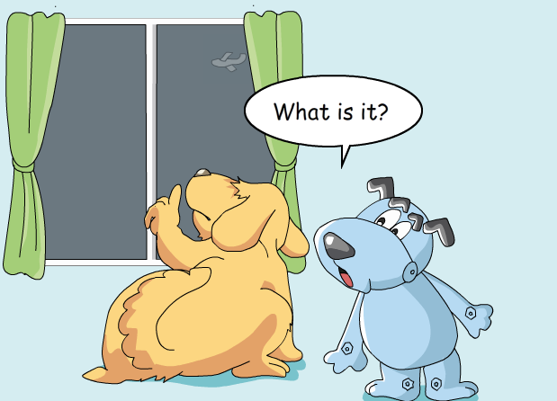
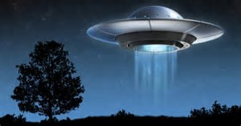

Watch a video and answer the following questions.
(1)What does Hobo think it is?
(2)What does Eddie think it is?
(1)Hobo thinks it is a plane.
Unidentified Flying Object
不明飞行物
(2)Eddie thinks it is a UFO.

Slide 7
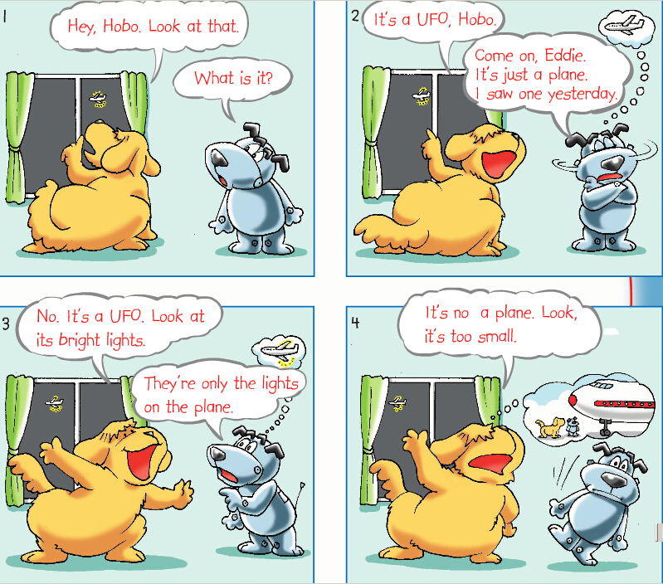
Act it out
1. Use different tones (语气).
2. Add your own actions to make the dialogue more interesting.
t

Slide 8


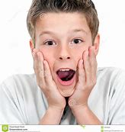
The Sun is about 1,300,000 times larger than the Earth.
Fish sleep with their eyes open.
You cannot sneeze(打喷嚏) and keep your eyes open at the same time.
There are no bones in the back of elephants’ feet — only fat.
Our eyes are the same size from birth, but our nose and ears never stop growing.

Slide 9
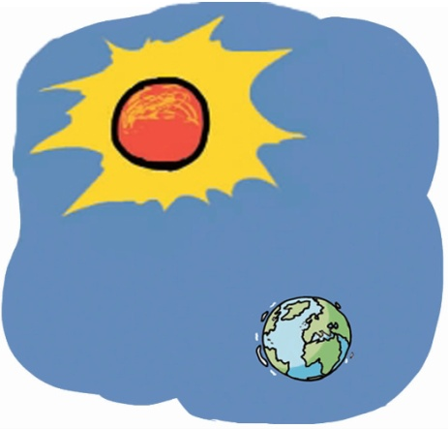
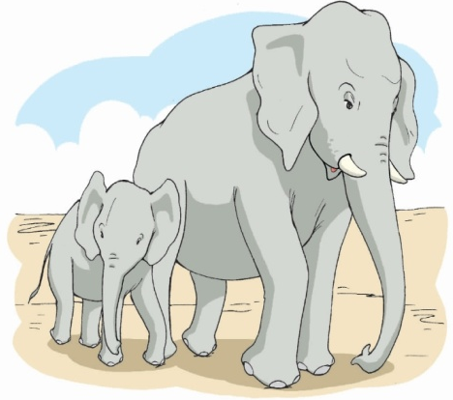
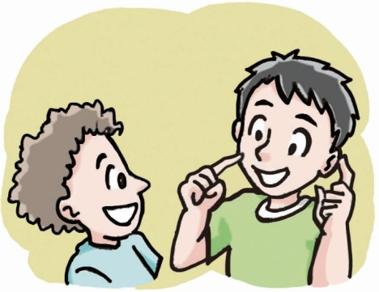
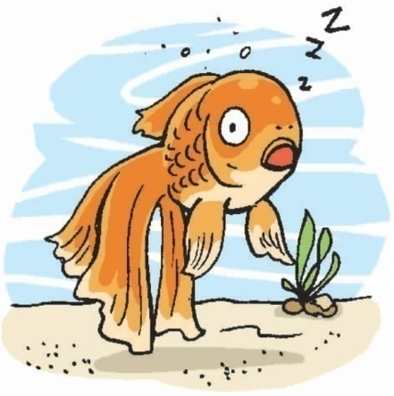
a Fish sleep with their eyes open.
b Our eyes are the same size from birth, but our nose and ears never stop growing.
A
Your friend is showing you a book about some unusual things. Work in pairs. Look at the pictures and match them with the sentences.
(P 57)
c The Sun is about 1,300,000 times larger than the Earth.
d There are no bones in the back of elephants’ feet — only fat.

Slide 10



Kitty and Amy are talking about the fun facts in Part A. Listen to their conversation and answer the questions.
B
1.Which pictures are they talking about?
2.What do they think of the facts?
√
√
They think they’re interesting and amazing.

Slide 11
Fill in the blanks below.
Kitty: Do you know any fun facts about the
world?
Amy: Yes. The Sun is about 1,300,00 times
______ _____ the Earth.
Kitty: That’s __________! _____ ______
fish?
Amy: Fish sleep __________________.
Kitty: Oh, really?
Amy: Yes. _____ that ________?
larger than
interesting
What about
with their eyes open
Isn’t
amazing

Slide 12
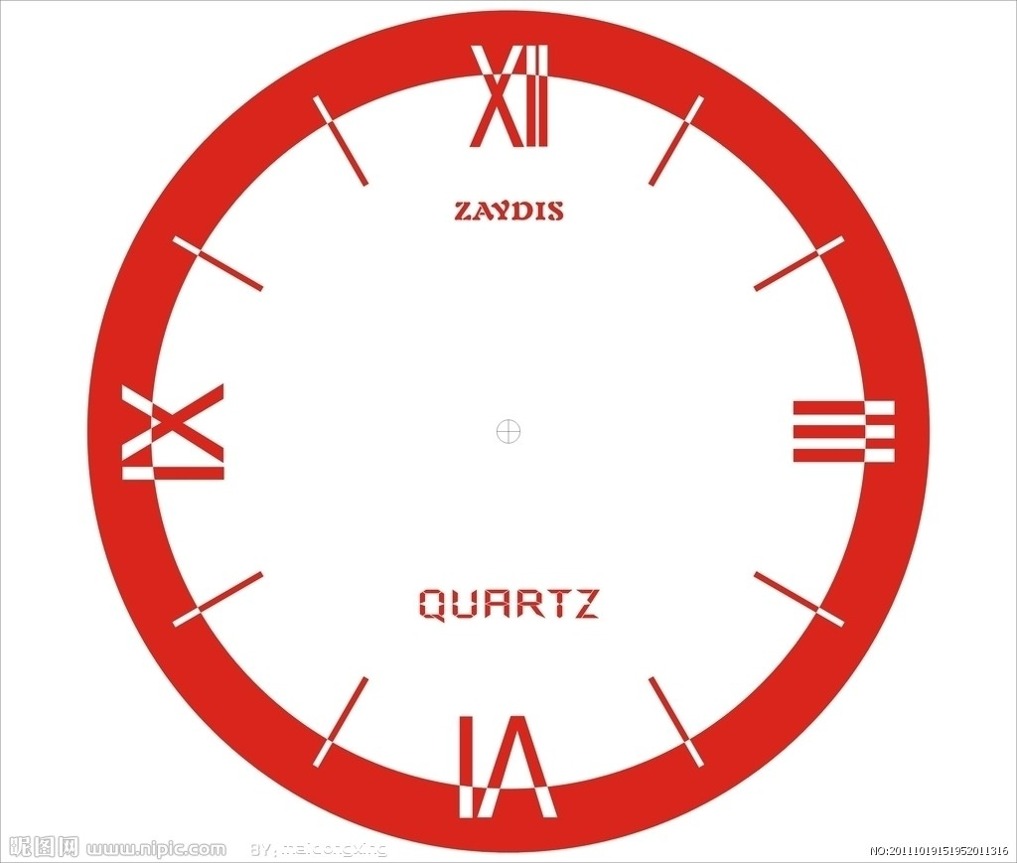

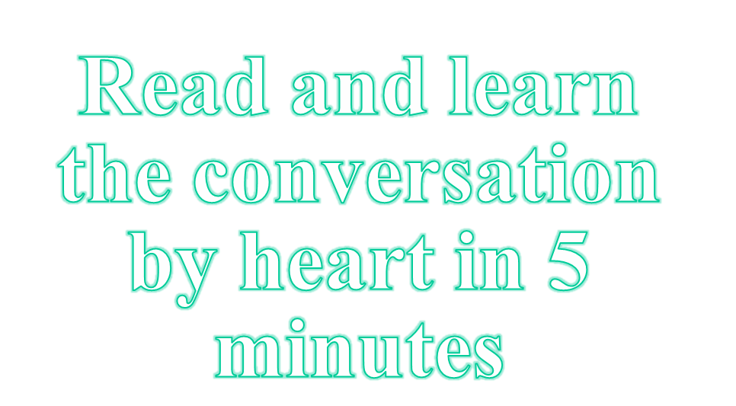

Slide 13
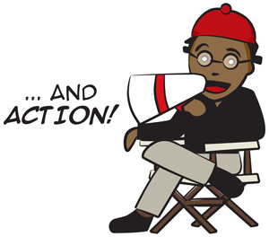
Role-play
We’ll see which group does the best.
Kitty
Amy
Do you know any fun facts about the world?
Yes, the sun is ___ ____ ____ ____ the earth.
That’s interesting! What about fish?
Fish ___ ____ ____ ____ ____.
Oh, really?
Yes. ___ ___ ____?

Slide 14
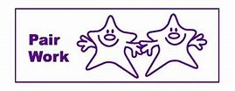
Work in pairs and talk about the fun facts with the words in the box.
amazing cool funny
great interesting wonderful
Example:
A: Do you know any fun facts about the world?
B: Yes….
A: That’s interesting! What about…?
B:…

Slide 15
Language points
1. Come on.
常用于口语中表达召唤、安慰、鼓励、
催促、不耐烦等很多意思。译为“行啦！
得了！来吧！好啦！”
①Oh come on, Kylie, you made the same excuse last week!
噢，得了吧，凯莉，上周你也是同样的借口！
②Come on! Don’t cry like a child.
好啦！别哭得像个孩子。

Slide 16
2. The world is full of amazing things.
be full of … 充满了……
①The shelves were full of books.
那些架子上摆满了书。
②You're always so full of energy.
你总是如此精力充沛。
③When she looked at him her eyes were full of tears.
当她看着他的时候，眼中饱含着泪水。

Slide 17
3. Fish sleep with their eyes open.
with+名词+形容词/介词短语
这种结构通常在句中起状语、定语作用，或用来对句子或某一成分作补充说明。此处在句中作状语。
①He likes to sleep with the window closed.
他喜欢关着窗户睡觉。
②Don’t speak with your mouth full.
当你满嘴食物的时候不要说话。

Slide 18
4. The Sun is about 1,300,000 times larger than the Earth.
用times表倍数时，一般仅表示三倍或三倍以上的数。
句式为：A + be + 倍数 + 形容词比较级 + than + B
①This hall is five times bigger than our classroom.
这个大厅比我们的教室大 5 倍。
②Line AB is three times longer than line CD.
线段 AB 是（线段） CD 的三倍长。

Slide 19

QUIZ
Ⅰ根据句意及所给首字母提示完成句子。
1. Pandas are pink, small and very lovely at
b____.
2. I can’t move. The room is f____ of people.
3. Some f____ about the Palace Museum are
amazing.
4. Our pencils are the s____. I don’t know
which one is mine.
5. Too much f__ in hamburgers is not good
for your health.
irth
ull
acts
ame
at

Slide 20
Ⅱ按提示完成句子。
is full of
The air __________(充满……的) the fragrance (香味) of flowers.
He slept in the room _______________(让灯开着).
The dictionary is exactly __________(五倍)thicker than that one.
Do you know any animal __________(有趣的事)?
with the light on
five times
fun facts

Slide 21
Homework
Talk about the amazing things
you know.
2. Finish the exercises in Learning English.
3. Preview Millie and Amy’s story on page 58.

